Slide 1

Guatemala SQL Server group
October 2018

Slide 2



Slide 3
Christian Araujo @charaujo
Carlos Lopez @CarlosLopezSQL
Eduardo Pivaral @EduardoDBA
Carlos Robles @dbamastery
gtssug.pass.org
github.com/GTSSUG
Board Members

Slide 4

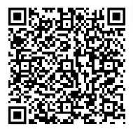
LSDISM0UC
PASS Summit 2018 Registration Offer
Save $150 USD
Register for PASS Summit and as a member of SQL Server local user group Guatemala you can save $150 USD off your conference registration price.
To access your exclusive discount, use code LSDISM0UC when you register and your savings will calculate at time of registration. Register between September 17 – 22, 2018 and be entered into a daily prize draw, and grand prize draw for a COMP to PASS Summit 2019**!
*Unique discount code cannot be applied retroactively and cannot be combined with any other offers.
** Terms and Conditions apply – scan QR code to view.
GROUP REFERRAL DISCOUNT CODE
PASS Summit is the largest conference for technical professionals who leverage the Microsoft Data Platform.
Get the skills and community connections you need to advance your company and career.

Slide 5
Upcoming Virtual Group Webinars
Virtual Group | Meeting Date | Time | Topic | Website
Saturday Night SQL | 11-Nov-18 | 01:00 – 02:30 (UTC) | Populating a Data Warehouse with SSIS and BimlSnap - Jim Miller | saturdaynightsql.pass.org
DBA Fundamentals | 13-Nov-18 | 02:30 – 03:30 (UTC) | Introduction and Use cases for working with Azure Databricks - Ginger Grant | fundamentals.pass.org
Global Italian | 14-Nov-18 | 17:00 – 18:00 (UTC) | Real-Time Dashboard in Power BI - Andrea Uggetti | globalitalian.pass.org
DBA Fundamentals | 20-Nov-18 | 17:00 – 18:00 (UTC) | An Introduction to Partitioning - Andrew Pruski | fundamentals.pass.org
Women in Technology | 28-Nov-18 | 17:00 – 18:00 (UTC) | Using Azure Databricks, a scalable data solution – Ginger Grant | wit.pass.org
Professional Development | 29-Nov-18 | 17:00 – 18:00 (UTC) | Busy is a Four-Letter Word - Jes Borland | professionaldevelopment.pass.org

Slide 6

Upcoming SQLSaturdays
US/Canada
EMEA
Oct 20 Charlotte
Oct 27 Lincoln
Nov 03 Oregon
Oct 13 Holland
Oct 13 Sofia
Oct 20 Madrid
Oct 27 Munich
Nov 03 Banja Luka
Nov 24 Tallinn
LATAM
APAC
Oct 13 El Salvador
Oct 20 Salvador
Nov 17 Costa Rica – BI
Nov 24 Rio de Janeiro
Nov 24 Bangladesh
Visit sqlsaturday.com to register for an event near you!

Slide 7

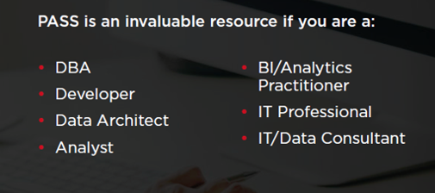
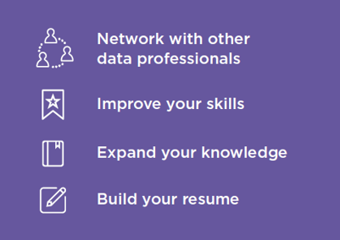

Join PASS to Grow Your Career
Connect with a global network of 250,000+ data professionals
Become a member and gain free access to:
Online educational content
Live webinars
In-person meetups, events, and conferences
Networking, volunteering, and speaking opportunities
The Community
The Benefits
… Join Today!
Notes:
PASS is a global, not-for-profit association where data professionals Connect, Share and Learn.
Joining PASS is free, and gives you access to hundreds of hours of free online content, live virtual and in-person events, the ability to join Local Groups in your area, and an annual conference, PASS Summit.
PASS is a great way to connect with like-minded professionals, increase your technical expertise, and grow your career.

Slide 8

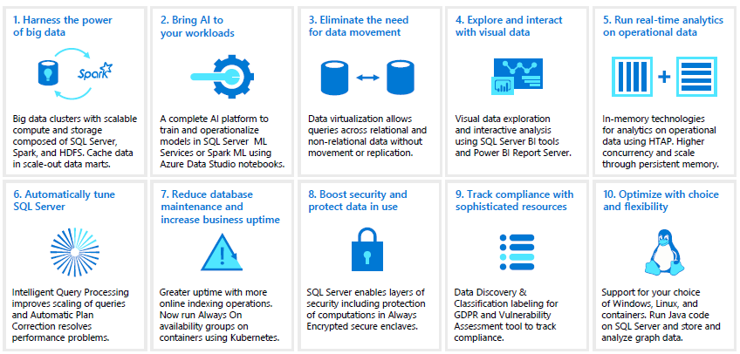
Newsletter
SQL Server 2019 CTP: it is live! you can learn more about the new features and give it a try:
https://www.microsoft.com/en-us/sql-server/sql-server-2019

Slide 9

Congratulations to Allan Barrera for his new job!!!
@guatemallan
in/guatemallan

Slide 10
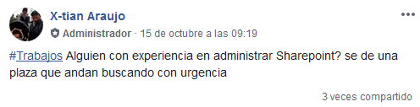
Job openings
Contact Christian Araujo (@charaujo) for more information

Slide 11
Articles:
SSIS Basics: Bulk-Import various text files into a table (Eduardo Pivaral)
Featured blog posts:
How to embed a PowerBI report into HTML code (Eduardo Pivaral)
Creating Wait stats widget on Azure Data Studio for macOS (Carlos Robles)
Starting SSMS with a specific connection and script file (Carlos Robles)

Slide 12
Articles:
SQL Server Parallelism Overview (Pablo Echeverria)
SQL Server Database Mirroring Inventory and Monitoring Scripts (Alejandro Cobar)
Script to obtain most recent SQL Server backup information for all databases (Alejandro Cobar)
Using COMPRESS and DECOMPRESS in SQL Server to Save Disk Space (Eduardo Pivaral)
Capturing SQL Server Deadlocks using Extended Events (Eduardo Pivaral)

Slide 13
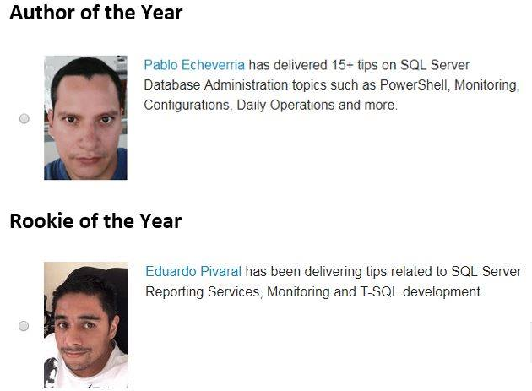
Pablo Echeverria and Eduardo Pivaral were nominated for 2018 MSSQLTips awards.
You can vote every day for them (until Dec 31 2018) at:
https://www.mssqltips.com/mssqltips-author-of-year/

Slide 14
Want to write technical articles?
Learn more on each site:
https://www.mssqltips.com/contribute/
http://www.sqlservercentral.com/About/WriteForUs
https://www.sqlshack.com/about-us/

Slide 15
Call for speakers
Want to participate as speaker in Guatemala's SQL Server User Group monthly meeting? then visit:
https://gtssug.pass.org/en-us/sessionsubmission.aspx

Slide 16
Main Presentation
Cómo aprovechar el paralelismo en SQL Server
Pablo Echeverria, Logical Database Administrator, Atos Guatemala
En SQL Server a menudo nos encontramos con que el uso de CPU, memoria, disco o tiempo de ejecución llega hasta el límite más alto, y después de buscar la causa nos damos cuenta que hay consultas, aunque a simple vista sencillas, que consumen estos recursos. ¿Por qué ocurre esto, y cómo podemos resolverlo? La respuesta se encuentra en la automatización de procesos y aprovechamiento del paralelismo en SQL Server, lo cual se enseñará en esta sesión interactiva que incluye ejemplos prácticos y reales que puedes aplicar en el día a día.
About Pablo:
Pablo Echeverria, tiene más de 13 años de experiencia en desarrollo de aplicaciones críticas de alto impacto y de elevado número de usuarios simultáneos, Pablo cuenta con certificaciones en SQL Server 2012-2014. Disfruta de viajar y conocer nuevos lugares, lo cual le permite tener nuevas experiencias de vida.
Linkedin: https://www.linkedin.com/in/pablo-echeverria/
MSSQLTips: https://www.mssqltips.com/sqlserverauthor/267/pablo-echeverria/

Slide 17

Sponsors
Want to become a sponsor? Send an email to: gtssug@gmail.com

Slide 18
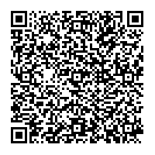
Resources
For all the links just scan the following QR code:

Slide 19


Follow us
Sign up for a free membership today at:
GTSSUG.PASS.org
#SQLPassGT @gtssug

Slide 20


Connect with PASS
Sign up for a free membership today at:
PASS.org
#sqlpass @sqlpass
@passcommunity

